Slide 1
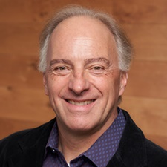
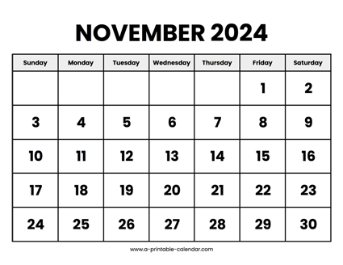
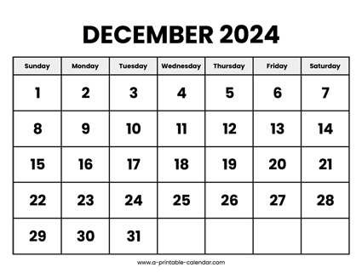

CS 310 : Scalable Software Architectures
Week 10 (Nov 25 – Nov 29)
This week in CS 310:
Focus this week:
Authentication
Thanksgiving break!
Project 04 released
What's left?
Exam 02 on Tuesday 12/03
Final project due Friday 12/06
Project #04 due Friday 12/13 (finals week)

Slide 2
Topics
Authentication
Users
Passwords
Tokens

Slide 3
Class sessions
Tuesday:
Let's plan to meet
Security, authentication
Exam #2 practice problems
Thursday:
No class --- thanksgiving!

Slide 4
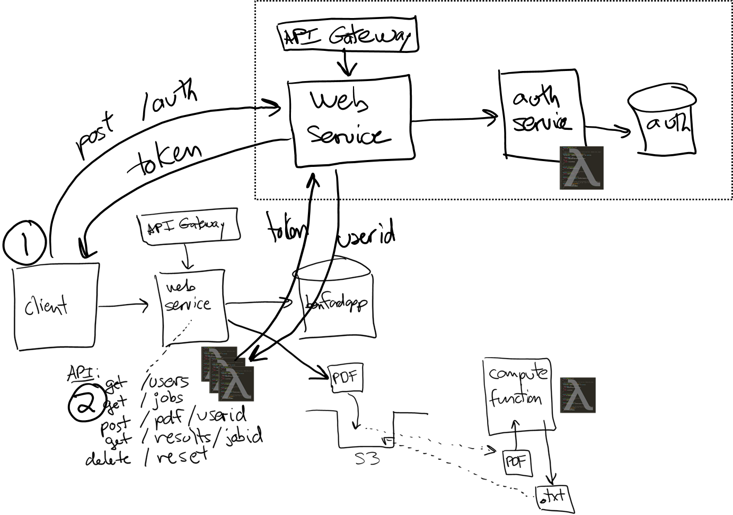
Project 04
Project 04 adds authentication (users & pwds)

